Slide 1

HOPE
FOR HUMANITY

Slide 2

ABSTRACT
An NGO (Non-Governmental Organization) is a non-profit group that works independently of the government to help people, protect the environment, or address social issues. They often rely on donations and volunteers to carry out their work.

Slide 3
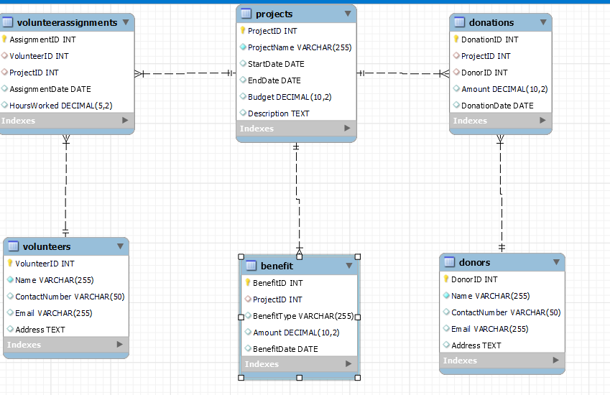
ENTITY RELATION DIAGRAM

Slide 4

DATABASE NGO – HOPE FOR HUMANITY

Slide 5
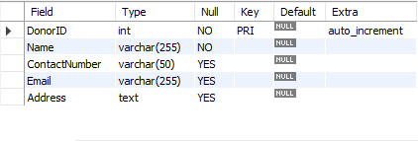
STRUCTURE OF TABLE
DONOR TABLE
This table is designed to store
and manage key information
about donors, including their
unique id, name, contact Number ,Email, and
and address.
SYNTEX : DESC Doners;

Slide 6
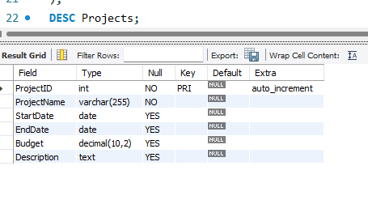
STRUCTURE OF TABLE
PROJECTS TABLE
THIS TABLE SHOWS THE PROJCET ID WHICH IS PRIMARY KEY AND ALSO HOLDS THE INFORMATION LIKE PROJECT NAME ,START_DATE, END_DATE, BUDGET, & DESCRIPTION ETC.
SYNTAX: DESC Project;

Slide 7
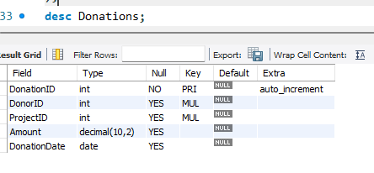
STRUCTURE OF TABLE
Donation table
THIS TABLE SHOWS THE DONATIONID WHICH IS PRIMARY KEY AND DONORS ID PROJECT ID BOTH ARE FOREIGN KEY , ALSO HOLDS THE INFORMATION LIKE AMOUNT, DONATION DATE ETC .
SYNTEX: DESC Donation;

Slide 8
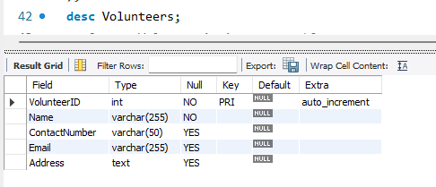
STRUCTURE OF TABLE
VOLUNTEERS TABLE
THIS TABLE SHOWS THE VOLUNTEER ID WHICH IS PRIMARY KEY AND ALSO HOLDS THE INFORMATION LIKE NAME,CONTACTNUMBER, EMAIL, & ADDRESS ETC.
SYNTEX:DESC Volunteers;

Slide 9
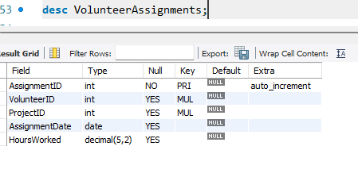
STRUCTURE OF TABLE
VOLUNTEERSASSIGNMENT TABLE
THIS TABLE SHOWS THE ASSIGNMENTID WHICH IS PRIMARY KEY AND VOLUNTEERID PROJECTID BOTH ARE FOREIGN KEY ALSO HOLDS THE INFORMATION LIKE ASSIGNMENTDATE HOURSWORKED ETC.
SYNTAX: DESC VolunteerAssignments;

Slide 10
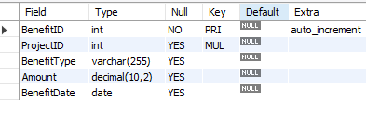
STRUCTURE OF TABLE
BENEFITS TABLE
THIS TABLE SHOWS THE BENEFITID WHICH IS PRIMARY KEY,PROJECTID ARE FOREIGN KEY & ALSO HOLDS THE INFORMATION LIKE BENEFITTYPE,AMOUNT, BENEFITS DATE ETC.
SYNTAX: DESC BENEFITS;

Slide 11
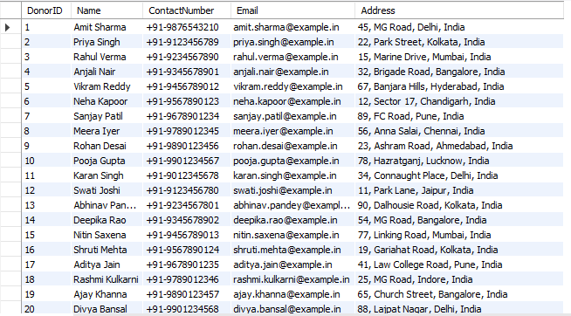
CONTENTS OF TABLE

Slide 12
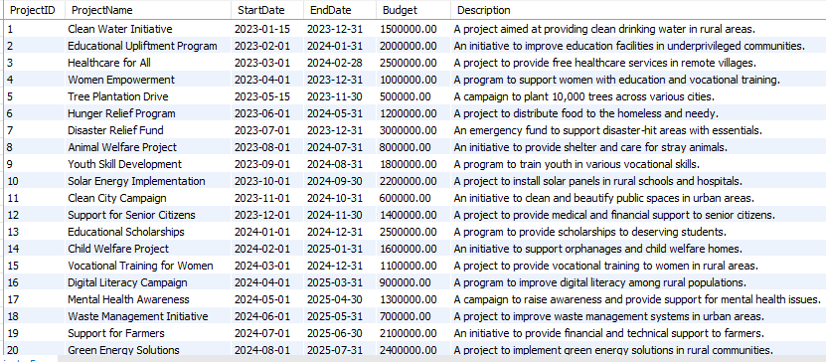
CONTENTS OF TABLE

Slide 13
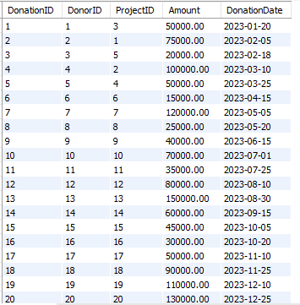
CONTENTS OF TABLE

Slide 14
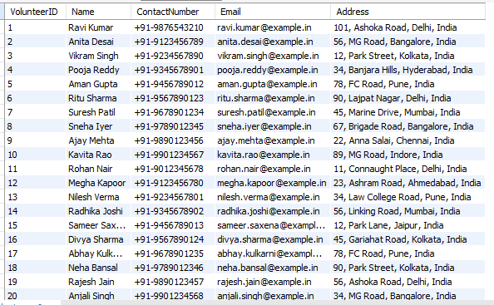
CONTENTS OF TABLE

Slide 15
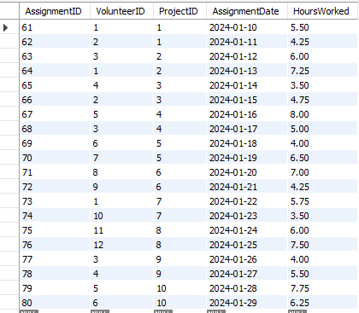
CONTENTS OF TABLE

Slide 16
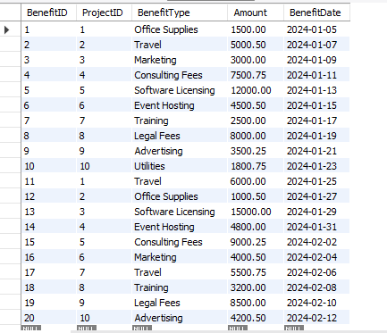
CONTENTS OF TABLE

Slide 17

C
SUBQUERY

Slide 18
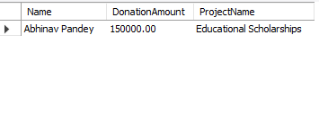
SUBQUERY
FIND THE NAMES OF VOLUNTEERS WHO ARE ASSIGNED TO THE PROJECT WITH THE HIGHEST TOTAL BENEFITS.
SYNTAX:
SELECT Name, (SELECT MAX(Amount) FROM donations) AS DonationAmount, (SELECT ProjectName FROM Projects WHERE ProjectID = (SELECT ProjectID FROM donations WHERE Amount = (SELECT MAX(Amount) FROM donations) LIMIT 1) ) AS ProjectNameFROM donorsWHERE DonorID = (SELECT DonorID FROM donations WHERE Amount = (SELECT MAX(Amount) FROM Donations) LIMIT 1);

Slide 19
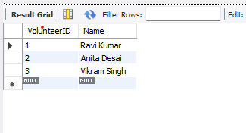
SUBQUERY
FIND VOLUNTEERS ASSIGNED TO PROJECTS WITH SPECIFIC BENEFITS.
SYNTAX:
SELECT VolunteerID, NameFROM VolunteersWHERE VolunteerID IN ( SELECT VolunteerID FROM VolunteerAssignments WHERE ProjectID IN ( SELECT ProjectID FROM Benefit WHERE BenefitType = 'Office Supplies' ));

Slide 20
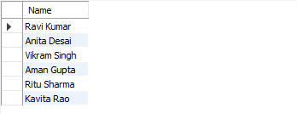
subquery
Find the names of volunteers who have worked on projects that received a donation amount greater than ₹1,00,000.
SYNTAX:
SELECT Name
FROM Volunteers
WHERE VolunteerID IN ( SELECT VolunteerID
FROM VolunteerAssignments
WHERE ProjectID IN (SELECT ProjectID
FROM Donations
GROUP BY ProjectID
HAVING SUM(Amount) > 100000 ));

Slide 21
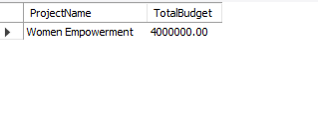
subquery
What is the total budget allocated to the "Women Empowerment" project?
SYNTAX:
SELECT ProjectName, SUM(Budget) AS TotalBudgetFROM ProjectsWHERE ProjectName = 'Women Empowerment'GROUP BY ProjectName;

Slide 22

JOINS
JOINS

Slide 23
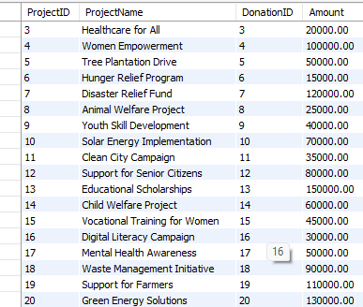
LEFT JOIN
"What are the project names and their corresponding donation amounts? Include all projects, even those without donations.
SYNTAX:
SELECT Projects.ProjectID, Projects.ProjectName, Donations.DonationID, Donations.AmountFROM ProjectsLEFT JOIN Donations ON Projects.ProjectID = Donations.ProjectID;

Slide 24
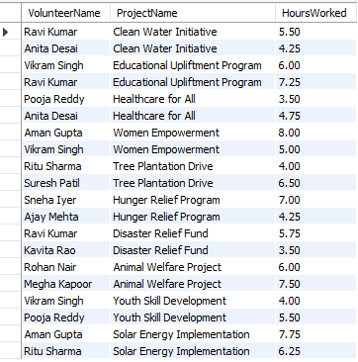
JOIN
List volunteer assignments along with the volunteer's name and the project name.
SYNTAX:
SELECT Volunteers.Name AS VolunteerName, Projects.ProjectName, VolunteerAssignments.HoursWorkedFROM VolunteerAssignmentsJOIN Volunteers USING (VolunteerID)JOIN Projects USING (ProjectID);

Slide 25
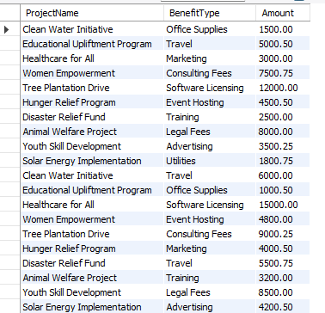
RIGHT JOIN
Retrieve all benefits and the projects they are associated with, including projects without benefits
SYNTAX:
SELECT
Projects.ProjectName,
Benefit.BenefitType,
Benefit.Amount
FROM
Projects
RIGHT JOIN
Benefit ON Projects.ProjectID = Benefit.ProjectID;

Slide 26
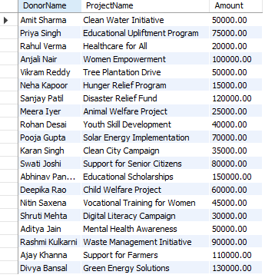
INNERJOIN
List the donors and the projects they have donated to
STNTAX:
SELECT
Donors.Name AS DonorName,
Projects.ProjectName,
Donations.Amount
FROM
Donors
INNER JOIN
Donations ON Donors.DonorID = Donations.DonorID
INNER JOIN
Projects ON Donations.ProjectID = Projects.ProjectID;

Slide 27

VIEW
JOINS

Slide 28
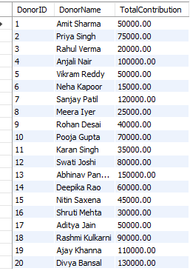
view
This view shows the total amount donated by each donor across all projects
SYNTAX:
CREATE VIEW DonorContributions ASSELECT d.DonorID, d.Name AS DonorName, SUM(do.Amount) AS TotalContribution FROM Donors d
LEFT JOIN Donations do ON d.DonorID = do.DonorIDGROUP BY d.DonorID, d.Name;

Slide 29
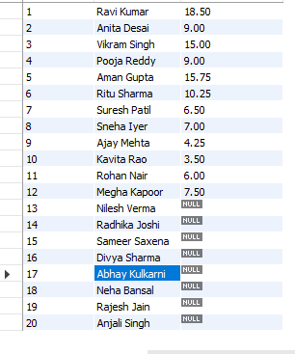
VIEW
This view shows the details of volunteers and the total hours they have contributed across all projects.
SYNTAX:
CREATE VIEW VolunteerContribution AS
SELECT
v.VolunteerID,
v.Name AS VolunteerName,
SUM(va.HoursWorked) AS TotalHoursWorked
FROM
Volunteers v
LEFT JOIN
VolunteerAssignments va ON v.VolunteerID = va.VolunteerID
GROUP BY
v.VolunteerID, v.Name;

Slide 30
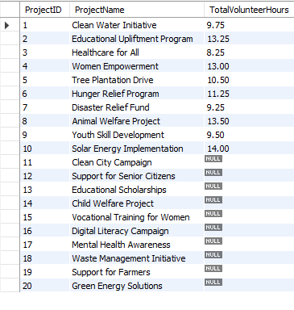
VIEW
This view lists all the benefits associated with each project
SYNTAX:
CREATE VIEW ProjectVolunteerHours AS
SELECT
p.ProjectID,
p.ProjectName,
SUM(va.HoursWorked) AS TotalVolunteerHours
FROM
Projects p
LEFT JOIN
VolunteerAssignments va ON p.ProjectID = va.ProjectID
GROUP BY
p.ProjectID, p.ProjectName;

Slide 31
PREPARED BY: MUSKAN MISHRA
THANKYOU

